Slide 1
LINKED LISTS

Slide 2
Like arrays, a Linked List is a linear data structure.
Linked lists are able to solve most of the limitations posed by arrays.
Arrays can be used to store linear data of similar types, but arrays have the following limitations:
1. The size of the arrays is fixed which forces us to know the number of elements in advanced.
2. Insertion of a new element / Deletion of a existing element in an array of elements is at the expense of other elements and space.

Slide 3
Why Linked List?
Linked lists have a few advantages over arrays:
1.Items can be added or removed from the middle of the list
2.There is no need to define an initial size
So what is a linked List ?
A linked list is a linear data structure that includes a series of connected nodes.
The Nodes arranged in such a way that each node contains a value and a pointer.
The pointer always points to the next member of the list.
Unlike arrays, linked list elements are not stored at a contiguous location; the elements are linked using pointers.

Slide 4
Types of Linked Lists
Single Linked List – You traverse the linked list in only one direction. Forward only ..where the next pointer of each node points to the other node but the next pointer of the last node points to NULL.
Doubly Linked List – In this type of linked list, one can move or traverse the linked list in both directions (Forward and Backward)
Circular Linked List – In this type of linked list, the last node of the linked list contains the link of the first/head node of the linked list.

Slide 5
Single Linked Lists
A single linked list is a list made up of NODES and each nodes consist of two parts The data and the link.
The data part contains the actual data that you need to store and the link part contains the address of the next node of the list.
The first node is called the head of the linked list.
If the linked list is empty, then the value of the head points to NULL.

Slide 6
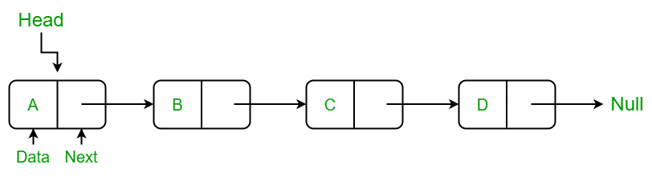
The address of the first node is called HEAD.
The last node in the linked list can be identified because its next portion points to NULL.

Slide 7
In C, we can represent a node using structures.
Below is an example of a linked list node with integer data.
struct node
{
int data;
struct node *link;
};
Eg : 50 , 76 , 88 , 92

Slide 8
Creating a linked list with many nodes in C :
#include <stdio.h>
#include <stdlib.h>
struct node
{
int data;
struct node *link;
};
int main( )
{ /* Initialize nodes */
struct node *head ;
struct node *one = malloc(sizeof(struct node));
struct node *two = malloc(sizeof(struct node));
struct node *three = malloc(sizeof(struct node));
struct node *four= malloc(sizeof(struct node));
/* Assign data values */
one->data = 50;
two->data = 76;
three->data = 88;
four ->data = 92;
head = one; // save address of the first node in head
/* Connect nodes */
one->link = two;
two->link = three;
three>link= four;
four->link = NULL;
printf(“%d”,one→data);
printf(“%d”,two-→data);
printf(“%d”,three-→data);
printf(“%d”,four-→data);
return 0 ;
}

